Slide 1
Training Tracks by Teaching Tracks
Session 2 But what can you do with them? #1 – exploring theme
Chris Walklett
MATERIALS PACK
walklettchris@hotmail.com / www.teachingtracks.co.uk

Slide 2
Ten Golden Rules

Slide 3
Care & consideration
Choose a song with care and consideration.
Familiarise yourself with it. Listen to it. Really listen to it.
Be respectful of the creative process it has gone through.
Immerse yourself in the song and all it has to offer.
Don’t cut this process short.
Notes:
Choose a song (or let your students chose one) with care and consideration – especially as to its theme.
When a song is selected, familiarise yourself with it. Listen to it, I mean really listen to it.
Sing along and maybe watch the video too. Immerse yourself in the song and all it (and everything connected to the song) has to offer.
Songs, good songs at least, have almost always gone through a lengthy creative process involving considerable time and thought. Be respectful of this and spend an appropriate amount of time preparing activities with this in mind.
Too often, I have observed, this process is cut-short, hence the reason for many poor, basic materials that fail to do justice to the song or its lyrics.

Slide 4
Pay attention to the lyrics
Locate the lyrics and read through them.
Have another listen with the lyrics in front of you.
The lyrics may be different from what you thought
– there could be misheard lyrics / mondegreens
…so be prepared for a surprise or two.
Notes:
Locate the lyrics and read through them.
Then have another listen to the song
with the lyrics in front of you.
Remember that due to factors such as connected speech, the lyrics may be different from what you thought - creating what is known as mondegreens i.e. misheard lyrics.
So be prepared for a surprise or two.

Slide 5
Relevance of themes
Think about the song’s theme/s
and what language emerges from it?
Does it fit any subjects taught or topical/current events?
Or look for songs online that fit into this subject area.
Notes:
Think about the song’s theme/s
and what language emerges from it.
Consider also whether it fits any subjects recently taught or topical/current events that may spark interest amongst your students.
Alternately, look for songs amongst online resources, databases etc. that fit into the subject area you wish to explore.

Slide 6
Mood!
Think about what mood the song evokes.
Students will appreciate letting music soak into them.
Think about linguistic outputs too -
such as conjuring up adjectives that describe the mood of the song, or drawing pictures based on it.
Notes:
Think about what mood the song evokes…
and plan associated activities with this in mind.
In our busy world, students may well appreciate the idea of sitting back and letting music soak into them.
Such activities can have linguistic outputs too - such as conjuring up adjectives that describe the mood of the song or drawing pictures which the song brings to mind.
This might work best with instrumental musical
– ambient or electronica for example.

Slide 7
Order & staging
Think about what you are going to do and in what order for example whether to listen to the song or the lyrics first.
Don’t follow a set formula though - let the individual song and your teaching experience guide you to the activities that suit and to the staging of these activities.
Notes:
Think about what you are going to do with the song
and in what order.
Consider at what point you are going to get them to listen to the song, at what point it’s best to introduce the lyrics
and at what point (if at all) you are going to use the video?
Instead of following any particular formula though,
you should let the individual song and your teaching experience guide you to the activities that suit and to the staging of these activities.
Staging is trial and error.

Slide 8
Linguistic possibilities
What linguistic possibilities emanate from the song?
For example are there any lexical sets in the lyrics?
What stands out from the song/s chosen?
Notes:
Think about what linguistic possibilities
emanate from the song chosen.
Are there any particular lexical sets in the lyrics for example that you could concentrate on, or any interesting tense uses, or any areas of pronunciation/phonetics to focus on? Etc.
What stands out from the song chosen?

Slide 9
Boundaries
Be prepared to be the boss (or the maestro!)
Control the activities –
set rules for what is done & when it is done.
Careful though, you want to
come over as a music freak not a control freak!
Notes:
Be prepared to be the boss (we could even say the maestro!)
Control the activities, setting firm rules for what is done
and when it is done - if your students just whip out their phones for the video and the lyrics this may invalidate future activities and thus they may not be discovering the full wealth of possibilities inherent in that song.
Having said this, ensure that you come over
as more of a music freak than a control freak!

Slide 10
Student focused
Take time to brainstorm ideas to suit your students.
Think:
What activities will they like? What will challenge them?
How can you adapt what’s in the song to your regular teaching style and your student’s hopes and expectations?
Notes:
Take time to brainstorm ideas as to how you are going to implement song-based activities to suit your students.
Think -
What activities will they like?
What activites will challenge them?
How can you adapt what’s in the song to your regular style of teaching and your student’s hopes and expectations.

Slide 11
Exude confidence
Use songs with confidence.
you’re doing something students will love & remember.
Don’t forget – songs are a fantastic text type with real pedagogic purpose …but in ELT/EFL we have disconnected with them due to a formulaic approach e.g. overuse of gap-fill etc.
Notes:
Use songs with confidence.
Remember you are doing something your students will love, and find memorable.
Don’t forget –
songs are a fantastic text type with real pedagogic purpose, but in ELT/EFL we have disconnected with them in recent years – this is at least partially due to a formulaic approach most notably evidenced through things we already discussed and the excessive use of activities such as gap-fill.

Slide 12
Some words of advice…
Possibly the hardest thing is to think about staging - what to do in what order (see Golden Rules) e.g.
when to introduce the lyrics
when to play the song
whether to use the video and if so when and how. To do this well is hard. I spent ages playing around with it. Read through the article in Session 1.
Ideally your lesson plan/materials should focus on both theme and language;
Theme (and extensions to that theme) * the theme should be meaningful. Please don’t make it banal.
Language (lexis, grammar, pronunciation etc.)
A good lesson plan will look at all 4 skills – the ‘productive’ skills (writing, speaking) and the, so-called, ‘receptive skills (reading, listening)
The materials should also be fun – parts at least e.g. playful activities or something kinaesthetic.
What can I use for a model?
For a basic lesson plan idea the Cyndi Lauper from Session 2. or for a more detailed look at how things are structured my 3 single samplers. QR codes next slide.

Slide 13
What do theorists have to say on the use of this resource?
Grammar in situ
Fomina & Merkulova (2000) believe that songs/song lyrics can help to reinforce grammar patterns. Bartle (1962) and Saricoban & Metin (2000) emphasise the myriad of uses for grammar found in song lyrics.
Pronunciation
Spicher and Sweeney (2007) - aid pronunciation and spoken fluency practice. Fomino (2002) - intonation and fluency. Schoepp (2001) - receptive listening practice. Tumanov, (1986) talks of their use with phonological skills and pronunciation. Fomina & Merkulova (2000) believe that songs can help experiment with intonation patterns.
Vocabulary
Fomina & Merkulova (2000) & Saricoban & Metin (2000) believe that songs/song lyrics can help aid vocabulary both receptively & productively. Polyglot Benny Lewis talks of “language hacking” - the picking up of essential words & phrases which he believes is well achieved through songs.
Miscellaneous
Maxim (2000) talks of the cultural understanding that can be gleamed from a song. Other areas of practise include listening comprehension and speaking Huy Le & Krisch (2008) reading and literacy Lems (2002)

Slide 14
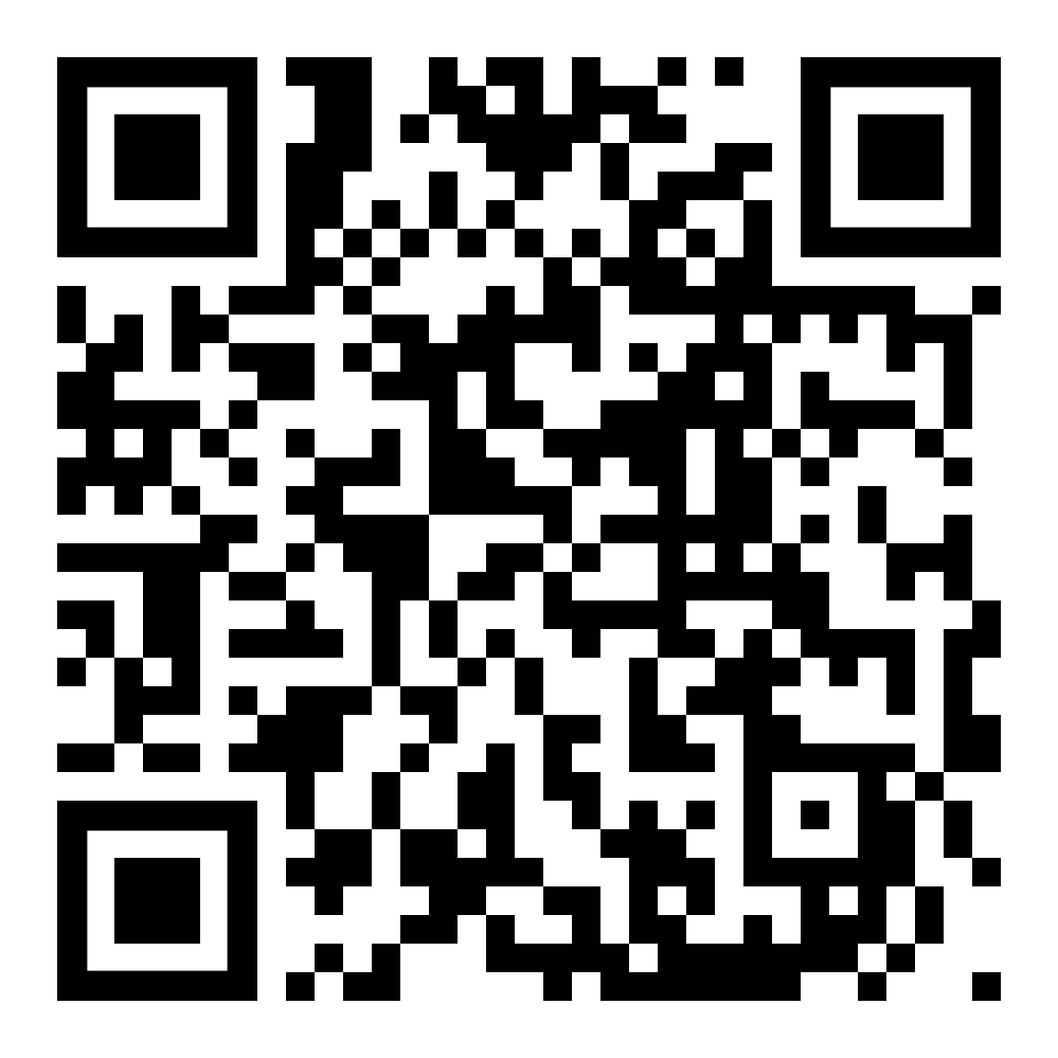
Mondegreens in action Yes, Today by Mark Hancock
https://www.youtube.com/watch?v=P1VN6rxXtKY
http://hancockmcdonald.com/sites/hancockmcdonald.com/files/file-downloads/Wrong%20Lyrics%20lesson.pdf
Follow the instructions – the video and lesson ideas can be found here - http://hancockmcdonald.com/materials/wrong-lyrics-1

Slide 15
A (not very complete) list of songs and their language areas Common grammar areas tenses etc. These are not easy to find and I’ve never had the time to work on one to busy writing materials ;) but It’s a starter for you to add to.
Grammar structures | Name of songs…artists are easy to Google
Present simple | You are my Sunshine, Little Boxes, Let it Be, My Bonnie, She Loves You
Past simple | A Day In the Life, Yesterday , Yellow submarine,
Future tenses | We Shall Overcome, I will survive,
Perfect tenses | Where Have All the Flowers Gone, I haven’t met you yet, Goodbye by Lover
Continuous (varied) | Sailing, Tom’s Diner
Conditionals | If I Had a Hammer, With A Little Help From My Friends ; If you don’t know me by now, If I were a Boy
Imperatives | I Will Survive, You Can Leave Your Hat On,
Questions | Who’s that Girl? What Have I Done to Deserve This? Blowing in the Wind, Where Have all the Flowers Gone?

Slide 16
Songs and their themes (controversial’/ social/ personal / political)
Topic area | Examples of songs that deal with these issues
Abuse | Luka, What’s the Matter Here, Don’t Talk, Make it Stop, JCB Song, Misguided Angel,
Addiction | A Team, The Bottle, Not an Addict, The Needle and the Damage Done, Mother’s Little Helper
Conflict with authority | This Land is Our Land, The Revolution Will Not be televised, The Law of the Land, Question Time
Educational failings & critique | Another Brick in the Wall Part II, Rat Race, Cherry Time, Don’t Stay in School, The Fear
Environmental destruction | Yellow Taxi, Eyes, Wide Open, Mercy Mercy Me(The Ecology), Don’t Go Near the Water, Saltwater
Health and well being issues | Everybody Hurts, Hurt, You’re not Alone, Don’t Stop, Video, Get Better, Stressed Out, True Colours
Gender issues / gender inequality | Just a Girl, Keep Ya’ Head Up, If I were a Boy, Woman in Chains, You Don’t Own Me, I Am Woman
Poverty . Social deprivation | The Way it is, Ghost Town, The Streets of London, The Message, In the Ghetto, Across 110th Street
Race/racial inequality | Strange Fruit, Whitey Gone to the Moon, Changes, Everyday People, Livin’ for the City, the Message
‘Self’ critique e.g. of own country | American Idiot, Let England Shake, Heartland, LDN, Born in USA, Oliver’s Army,
Sexuality (non-judgemental) | Same Love, Glad to be Gay, Born this Way, Lola, Cherry Lips, Walk on the Wild Side, I Am What I Am
War & conflict | Two Tribes, Shipbuilding, Galveston, The Unknown Soldier, Killing in the Name of, War, Where have all the Flowers Gone, Masters of War, Eve of Destruction, Draft Morning, War Pigs, Passchendaele

Slide 17
Your task for Monday 10th May
Song and artist
Why did you choose this song?
Class level (ESO/Bachiller) Subject:
Description of the activity Could include: pre- teaching vocab or prior knowledge. Type of tasks that accompany working with the song. Musical considerations, emotional aspect. Support materials (website, youtube..)
Expectations and predicted possible problems.
Student reaction to the song/activity (if applicable)
Your evaluation of the activity Expectations met? (if applicable) Student response? (if applicable) Unexpected problems/difficulties/surprises?
Song
Experience

Slide 18
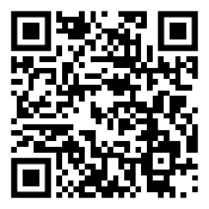
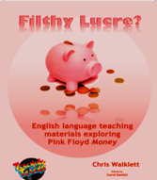
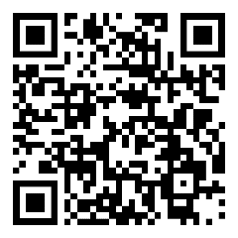
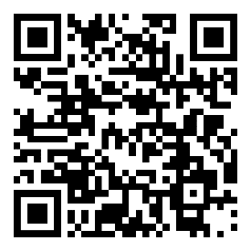
You can view these flip through books at
www.teachingtracks.co.uk
Here’s an example of what they contain…
https://orders.micropress.co.uk/share/5c754f261b2e812381603903
https://orders.micropress.co.uk/share/5c754f261b2e812381603905
https://orders.micropress.co.uk/share/5c754f261b2e812381603904
These are for sale (limited numbers) £5 each (6 euros) or 3 for £12 (15 euros) + p&p https://www.teachingtracks.co.uk/shop/

Slide 19
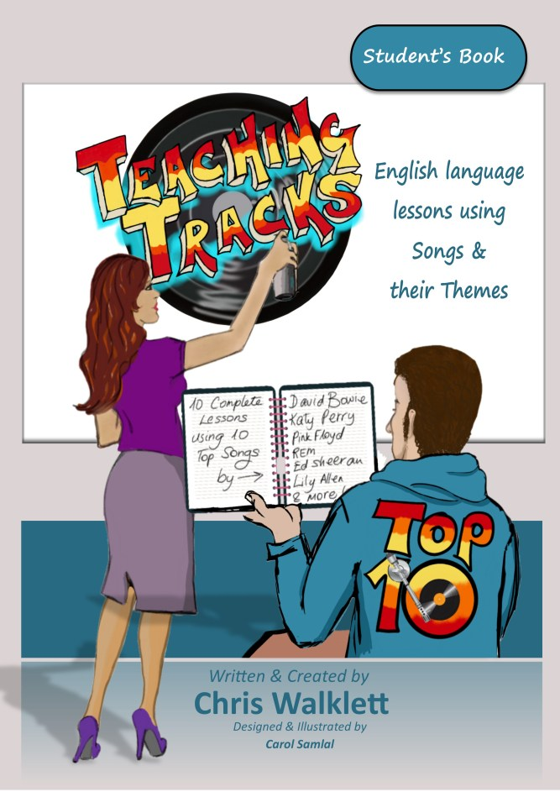
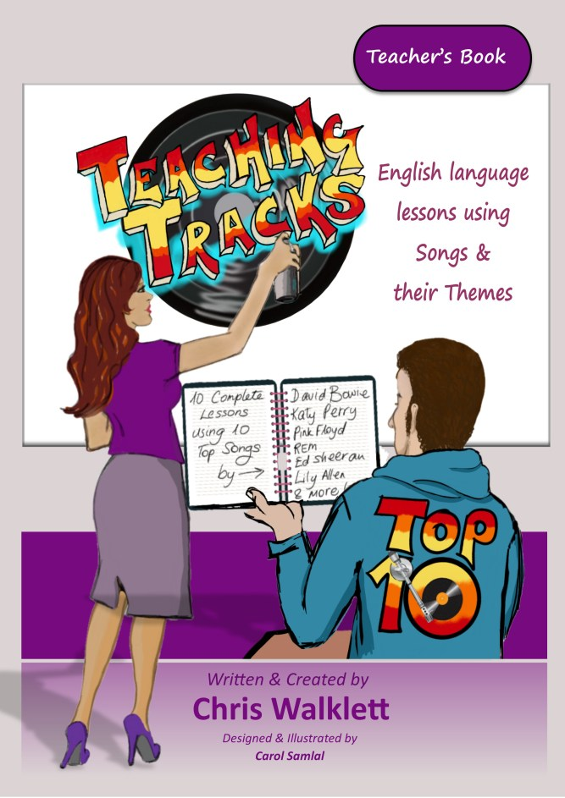
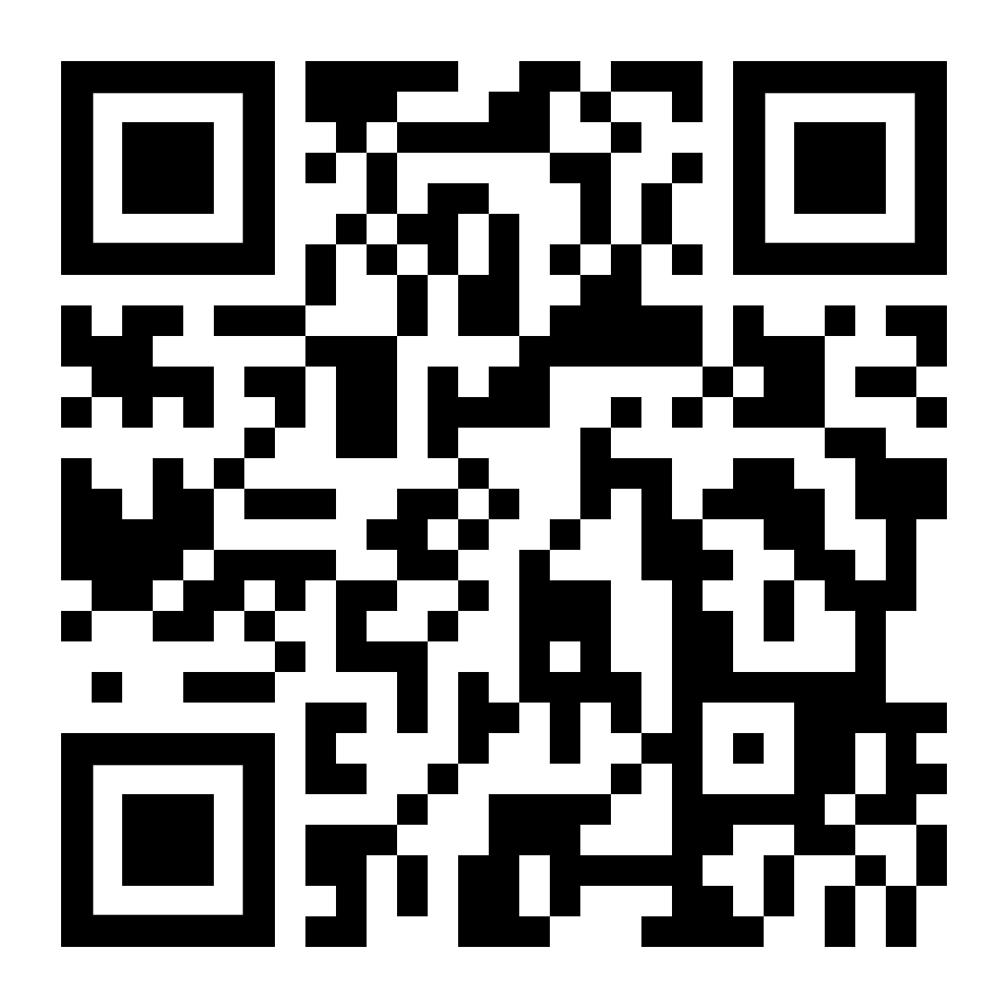
5 of the songs looked on this course feature in Top Ten, together with 5 more songs & lesson plans all appear in
Teaching Tracks: Teaching Tracks:
Top Ten Student’s book Top Ten Teacher’s Book
www.teachingtracks.co.uk

Slide 20
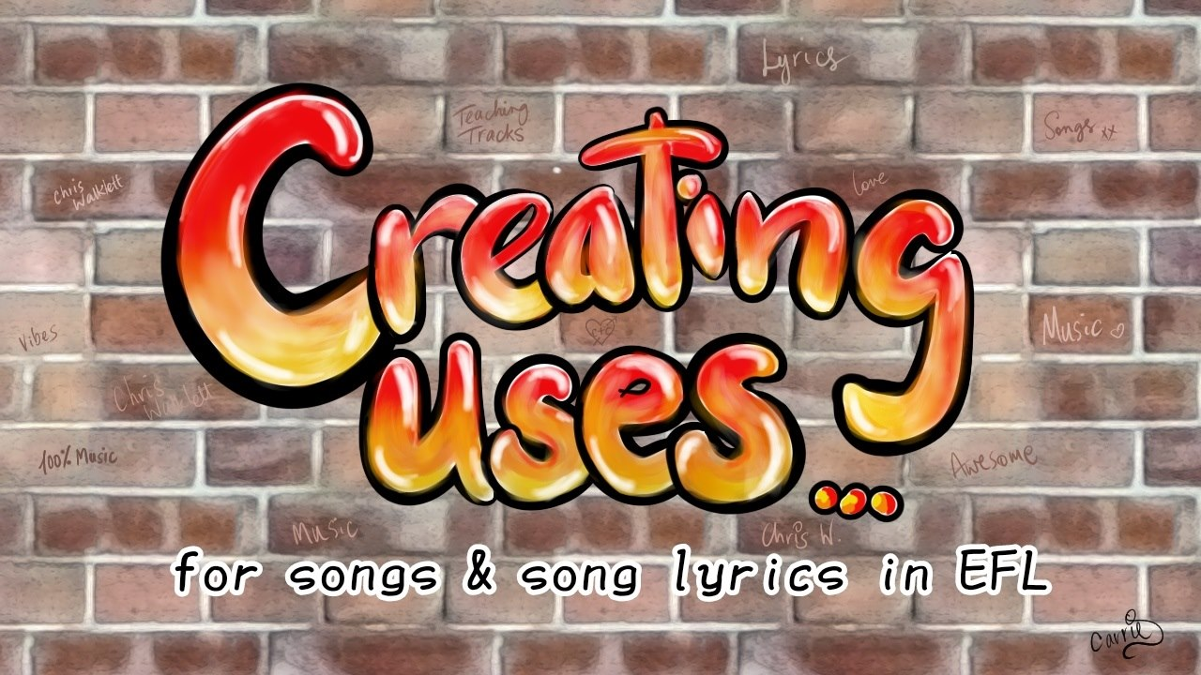
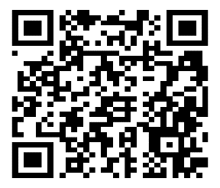
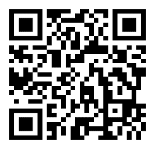
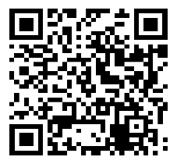
Please join my Facebook group
www.teachingtracks.co.uk
https://www.youtube.com/user/chrysalis66
/
walklettchris@hotmail.com

Slide 21
Some resources, I am aware that some are gap-fill but there are others too
www.tuneintoenglish.com some good lessons - need to register
www.lyricstraining.com fill out the words as young, different levels
www.fluentu.com – interactive subtitles on music videos
https://tefltunes.com/category/lessons/ pay site offering lesson plans from songs
http://elttraining.mdl2.com/mod/page/view.php?id=217
https://lyricalenglish.wordpress.com/ a blog with a few good song lesson plans
https://songswithstories.wordpress.com/ a blog with a few good song lesson plans
http://lessonstream.org Jamie Keddie’s site a few good lesson plan ideas.
https://sandraheyersongs.com/songs/ interesting site with some good stuff
http://evasimkesyan.com/2013/08/01/33rd-elt-carnival/
http://www.songsforteaching.com/esleflesol.htm ‘made for teaching’ songs
https://www.youtube.com/watch?v=rigdTOZ9THM... IH Tips on using songs.
http://busyteacher.org/classroom.../songs_and_lyrics/ gap fill
https://en.islcollective.com/resources/search_result... 1000s of gap fills
http://www.tubequizard.com/?fbclid=IwAR3enG3JflLYP55nAYkxfVUxE6mvsW8sa2YZYL0gxDNhSUgkjEqgIikfK58#levels:6,2/categories:11

Slide 22
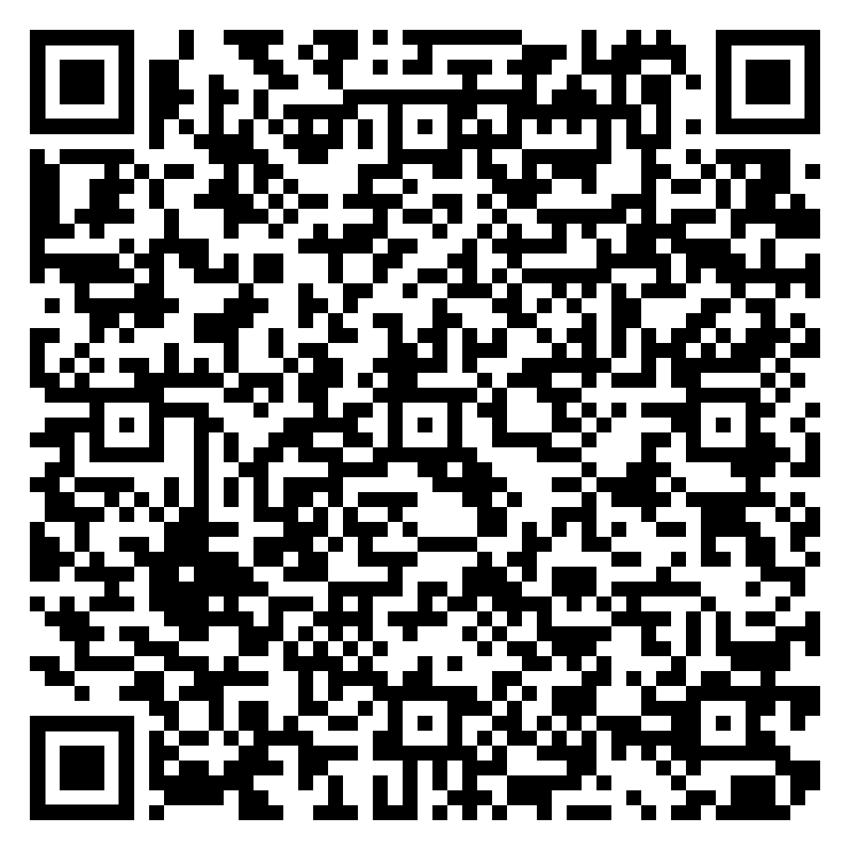
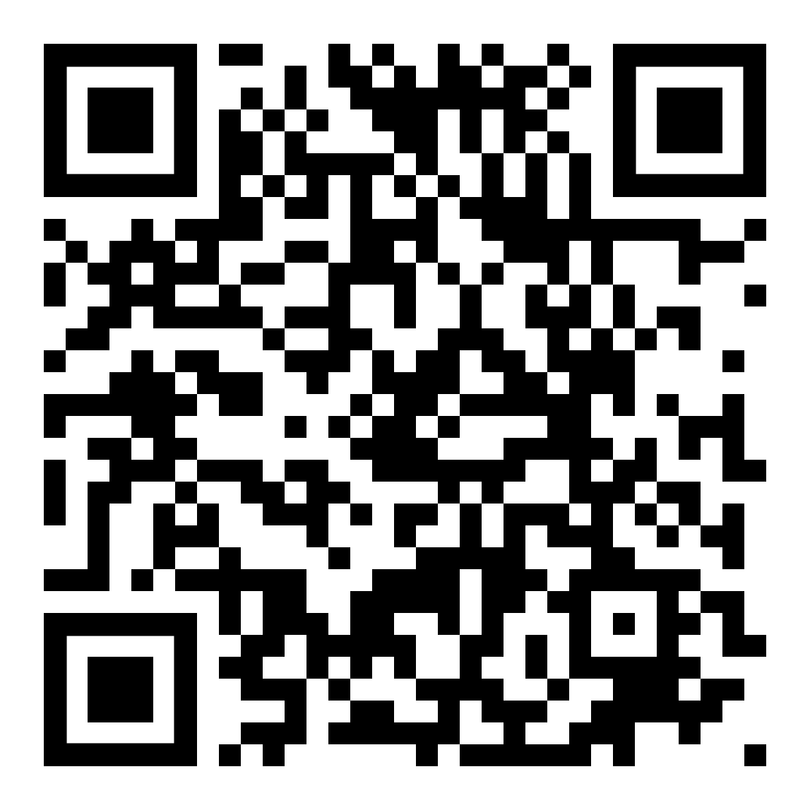
Further reading….
2 articles of mine from Humanizing English Language Magazine:
How to Teach Tracks: A Critique of the Uses of Songs and Song Lyrics, with Advice and Suggestions for Enhanced Usage
https://www.hltmag.co.uk/apr19/page/?title=How+to+Teach+Tracks%3A+A+Critique+of+the+Uses+of+Songs+and+Song+Lyrics%2C+with+Advice+and+Suggestions+for+Enhanced+Usage&pid=2471
On (or Off) Song? Are Producers of Materials Using Songs and Song Lyrics Making the Most of this Resource’s Potential?
https://www.hltmag.co.uk/apr19/on-or-off-song

Slide 23
Biblography
Bartle, G. (1962). Music in the language classroom. Canadian Modern Language Review, Fall: Cunningham, C. (2014). ‘Keep talking’: Using music during small group discussions in EAP. ELT Journal, 68(2), 179-191.
Diakou, Maria (2013). Using Songs to Enhance Language Learning and Skills in the Cypriot Primary EFL Classroom. EdD thesis The Open University
Engh, D. (2013). Why use music in English language learning? A survey of the literature. Language Teaching, 6(2), 113-127.
Failoni, J. (1993). Music as means to enhance cultural awareness and literacy in the foreign language classroom. Mid-Atlantic Journal of Foreign Language Pedagogy, 1, 97-108.
Fomina, A. S. & Merkulova, T. (2000). The use of songs in the EFL classroom. IATEFL-Ukraine
Newsletter, 18, 26-27. Green, J.M. (1993). Student attitudes toward communicative and non-communicative activities: The Modern Language Journal, 77, 1-10.
Griffee, D. (1992). Songs in action: Classroom techniques and resources. New York: Prentice Hall.
Hancock. M (1998) Singing Grammar. CUP.
Huy Lê, M. (1999). The role of music in second language learning: A Vietnamese perspective.
Jolly, Y. S. (1975). The use of songs in teaching foreign languages. The Modern Language Journal, 59, 11-14.
Keskin. F (2011) Using Songs as Audio materials. http://www.tojet.net/articles/v10i4/10438.pdf
Kirsten L (2001) Using Music in the Adult ESL Classroom, ERIC Digest
Ludke, K. M. Teaching Foreign Languages Through Songs.
Ludke, K. M, Ferreira, F. & Overy, K. (2014). Singing can facilitate foreign language learning. Memory & Cognition 42(1), 41-52. Language Learning Activities. Interactive Language Teaching

Slide 24
(Selected) Bibliography 2/2
Bibliography 2/2
Moi – C.F. – Rock Poetry Materials in the EFL classroom. Developing Materials for Language teaching
Maxim, H.H. (2000). Integrating language learning and cultural inquiry in the beginning foreign language classroom. ADFL Bulletin, 32(1), 12-17.
Medina, S.L. (1990). The effects of music upon second language vocabulary acquisition.
Millington, N.T. (2011) ‘Using songs effectively to teach English to young learners’, Language Education in Asia, vol. 2, no. 1, pp.134-141.
Murphey. T. (1992) Music and Song. OUP.
National Network for Early Language Learning, 6(3), 1-26. Salcedo, C.S. (2010). The effects of songs in the foreign language classroom on text recall, delayed text recall and involuntary mental rehearsal. Journal of College Teaching & Learning, 7(6), 19-30.
Saricoban, A. & Metin, E. (2000). Songs, verse and games for teaching grammar. The Internet TESL Journal, VI(10). http://iteslj.org/Techniques/Saricoban-Songs.html.
Schoepp, K. (2001). Reasons for using songs in the ESL/EFL classroom. The Internet TESL Journal, VII/
Spicher, L., & Sweeney, F. (2007). Folk music in the L2 classroom: Development of native-like pronunciation through prosodic engagement strategies. Connections, 1, 35–48.
Tumanov, A. (1986). Music in L2 pedagogy. Russian Language Journal, 40(136-137), 35-54.
Wassink. D (2011) What’s in a song? Teaching Language through Music. http://www.alea.edu.au/documents/item/195
Walklett, C. (2014) Have Attitudes to and Use of Songs and Song Lyrics in EFL Changed in Recent Years. Lecture. Available at: https://iatefl.britishcouncil.org/2014/session/changing-attitudes-using-songs-song-lyrics-efl
Walklett, C. (2015) The most important words you are ever going to hear! Available at https://www.youtube.com/watch?v=Z0yRU08UCy8&t=8s

