Slide 1
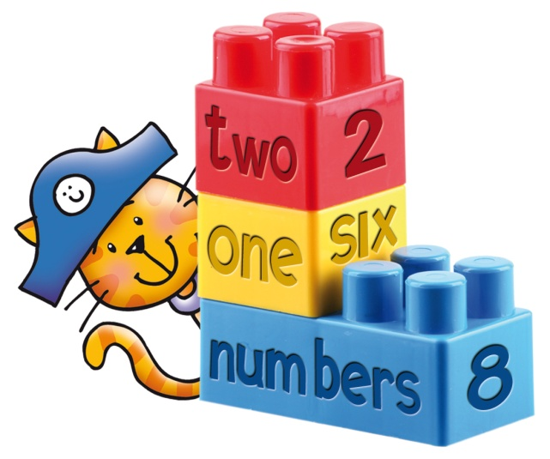
Module 1:Part 2 Development Section 1: Classroom Language

Slide 2
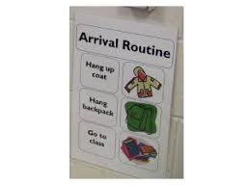
Where to Begin?
From the first moment with your class, it is important to establish the basic routines of:
How the children enter the classroom
Greet the teacher and each other
Check attandance
Tidy up…..Line up
Leave the classroom

Slide 3
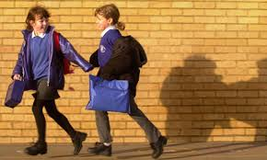
Teacher plays “the song of the week” on a interactive White board for 3/4 minutes as the children come into the classroom at the beginning of the school day.
During this song time, the children come in, hang up their coats, sit down, get settled and take out their material for the first class.
Entering the Classroom

Slide 4
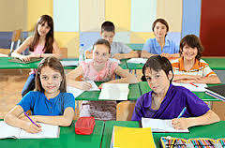
As the music ends the children know that it is now “Quiet time to listen to the teacher”
This is a very effective way to begin the class in an orderly and fun way.

Slide 5
Children will soon get into the habit of having a time limit to prepare themselves, while enjoying and singing along to the song.
The songs chosen can be part
of any project work that you
are working on or popular pop
songs that the children like.

Slide 6
The teachers should always try to use simple and positive language.
Never try to speak over the voices of the children.
Always insist on quiet, when you want to speak.
The children should

Slide 7
Language examples:settling down:
Please stop talking now
No more talking for a bit. Good.
That´s nice and quiet. You others sh..sh.. Calm down now. Ok. That´s better.
Quiet please. Settle down now and listen. That´s good Javier. Thank you Ana.

Slide 8
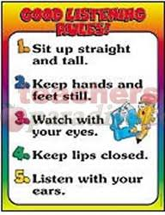
Everyone is sitting really nicely….except Maria, could you sit down like the others please?

Slide 9
Greetings
In Infants children work on Greeting in “Circle time”
as the teacher organizes the group to form a cirlce by singing “A Circle song”
“Make a circle
Make a circle
Make it round
Make it round
Make it in a hurry, Make it in a hurry
Then sit, then sit down.”
To the tune of “Where is Thumb man”

Slide 10
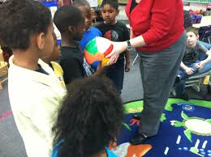
An object e.g.(a ball)
is then passed from one
child to the next in the circle as they
say “Good Morning” to each other
saying their names
“Good Morning Lucia”, “Hello Javier”

Slide 11
or with the help of the teacher as they say:
“My name is Lucia, What is your name?”
“How are you” etc.
(according to the language you want the children to learn)
and then pass the ball along.

Slide 12
In Primary, teachers do need to find ways to continue incorporating “Greeting Routines” to promote the child´s social and emotional development and introducting more language content.
Due to classroom layout and the size of the children, it may be more difficult to have the children sitting on the floor to continue the routine as in infants.

Slide 13
As an alternative the teacher can choose different children each day to come to the top of the class and act as “the teacher”.
The volounteer child can check attendance by saying:
Good Morning to the teacher
Good Morning to each child by name
Checking the register (using poster with children´s names or photos) to find out who is in school? and who is at home?

Slide 14
Language examples:Checking Attendance
Let´s call the roll
Let´s call the register
Let´s check to see who is here
Remember to answer I´m here
I´m
Here!

Slide 15
So everyone is here except……
No-one is absent today
No-one is missing
How many girls/boys are in the class today?
Where were you yesterday, Sofia? etc.

Slide 16
Javier is not in school today
Teacher “Does anyone know where Javier is?” Maybe he is at the doctor.
More vocabulary can be introduced according to the circumnstances.
A volounteer can also do the days of the week, the weather and feelings in a similar way.

Slide 17
Time to “Tidy Up” and “In the Line”
At the end of the class it is important to have an established routine for the children to “Tidy Up” and “Line Up”.
Use the song: “Everybody tidy up,
Tidy up, tidy up,
Everybody tidy up,
1….2…….3
Sing this in between using the appropriate classroom language e.g .

Slide 18
Language Examples: Ending the Lesson
Right, can you put everythig away now?
Ok, that´s all for now.
Right. We´ve no time for anything else-don´t do any more-we don´t have any more time today.
Ok, now stop. We haven´t enough time to finish the …writing..…etc………..today.

Slide 19
Ok, pick up all your things and put the books in the cupboard
That´s all for today. On Wednesday we will continue.
By using the routine of the “Tidy up “ song, the children will become accustomed to this being the prompt to let them know what they have to do.

Slide 20
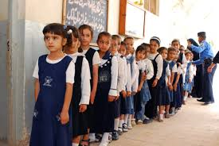
This same tune can be used to line up:
“Everybody in the line”
“In the line, in the line”
“Everybody in the line”
1…..2…..3
The teacher can establish his/her own rules of how to form the lines e.g.
Lines are formed with a boy, then girl behind, then boy etc

Slide 21
Lines are formed in pairs (children open to choosing their pair) but choosing a different partner everyday.
Lines are formed by classroom pair groups.
Teacher used “lollipop” names to say who goes first in the line.

Slide 22
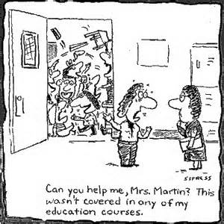
Keeping order in the “Line”
Waiting in a line is where
it can be easy to loose
control of your class, as the children usaully start chatting and “fooling around”.
Teachers do not want to shout to regain control of the group.
Some techiques that the teacher can use:

Slide 23
Teacher can start a chant…1.2.3.4.5 and then stops, all the children have to continue the chant..6.7.8.9.10, teacher continues 10.11.12.13.14.15 and the children continue 16.17.18.19.20 etc.
Teacher can use TPR techniques where the children have to follow what the teacher says and imitate her actions….hands on your shoulders,Hands on you head, Look at the child behind you etc.

Slide 24
Telling the Class what you are doing
Language Examples:
Today, we are going to do some ….
Now, I´m going to talk to you about…
Can anyone tell me….
First of all, what do we do when…..

Slide 25
Look carefully at…
What do you know about….
Over the next few lessons, we are going to..
Let´s do some together as a class first, so you´ll see what I mean, what to do, how to do it…
We´ll start like this…

Slide 26
In this lesson we are going to read….listen to a……
Today we are going to practice…
Next we are going to……
Match the picture with the Word…..

Slide 27
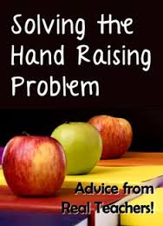
Teacher´s Tip
Get the children to write their names on Lollipop sticks and keep in a container on your desk.
Pull out a lollipop stick for a child to answer a question, first child to go in the line,´ child to act as the teacher etc.
This will perhaps keep them more attentive as they
never know who´s lollipop stick it will be.

Slide 28
Setting up pairs and groups
Classroom language has to be very clear in giving instructions for setting up group cooperative lessons.
The teacher can establish different ways of forming the groups :
Giving the children a number and then the same number have to form groups.

Slide 29
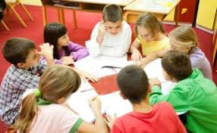
Give the children different stickers (animals, food etc) and then the same stickers have to come together to make groups.

Slide 30
Language Example:
Setting Groups for a jigsaw activity
Today you will be working in groups of fours to do a jigsaw activity.
Here on this table, I have stickers of different animals- A zebra, an elephant, a lion, a tiger.
I am going to give each table , 4 children a different sticker.

Slide 31
Teacher can use “lollipop” names to get helpers to give out the groups of stickers-1 helper gives zebras, another helper elephants etc.
Is everybody ready. Has everyone got a sticker.
Now children we all know that when we work in groups, each table has a different number.

Slide 32
Everyone take a look around the classroom and remember the table numbers. (have this very clear for the children to see)
This is where the teacher will draw the children´s attention to the classroom rules.
Ok children, I want you all to listen very carefully to the instructions.

Slide 33
Quietly all the zebras go to table No. 1
Well done zebras, You made very little noise.
Now all the elephants go to table No. 2
Lions to table No 3
And Tigers to table No 4.

Slide 34
Well done children
We are now ready to start our activity…….
Please check the “group rules” on each table. These will be rules the children will have decided on for working in groups.

Slide 35
For this activity you have to decide on 4 roles for each member of the team:
The zebra will be …….(the speaker)
The elephant will be………(the listener)
The lion will be…..(the observer) and
The tiger will be….(the Scribe).

Slide 36
Language Example: Games
Everybody sitting nicely in the circle
Look, this is how you shuffle the cards, mix them up
Give them out? Deal them out?
Here are some cards with phrases/actions on.

Slide 37
Don´t look at them yet.
Don´t look at anyone else´s.
Spread them out so that you can see all of them.
Which one make a pair?
Put the rest in a pile, face down.

Slide 38
Language example:
What children need to say and ask.
I haven´t got, I´ve lost, I´ve forgotton
Excuse me, can you help me?
Please Miss X, Is this right?
I don´t know what to do?

Slide 39
Please can I ask in Spanish?
How do – Can you spell that please?
How do – Can you pronounce that please?
I don´t understand
What´s_____________ in English.

Slide 40
How do you say________ in English?
What does ___________ mean?
Can you repeat that please?
Can I borrow a pen please?
Can we listen to that again?
I´m finished.

Slide 41
Can I go to the toilet please?
Can I drink some water please?
What do I do now – next?
See you tomorrow.

Slide 42
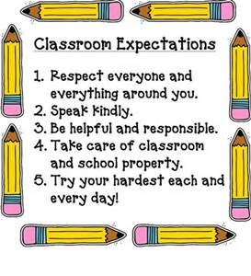
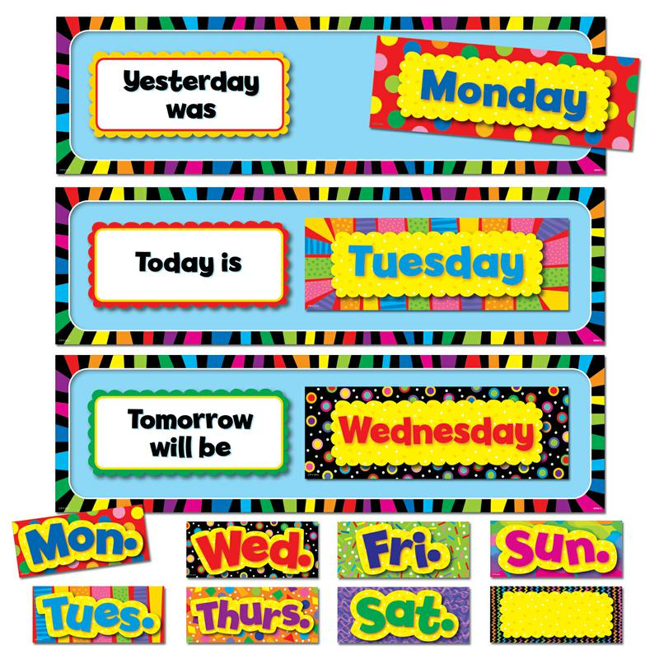
Classroom Language Conclusion
Have classroom Langauge displayed around the classroom

Slide 43
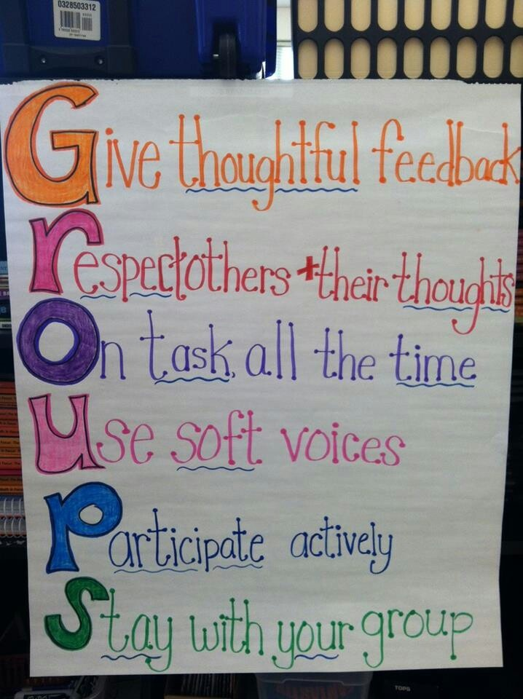
Change classroom
language displays
according to the
type of activity
or projects you
are working on.

Slide 44
Always speak in English and if the children speak in Spanish just repeat back what they have said in English.

Slide 45
Thank you for watching this PowerPoint presentation

